Slide 1
Web Service Development

Slide 2
Requirements
Perquisite Knowledge of any programming language such as Java, PHP VB.Net etc.
Webserver to host the developed web service.
Oracle Weblogic, Glassfish Server, IIS Server or WAMP
Client Program to be developed in any language.

Slide 3
Development of Web Service in Java using Netbeans
Netbeans IDE helps the developers to easily develop and test the web services.
Web service developed in Netbeans can be deployed to any server such as Glassfish server, Jboss server, Weblogic server.
We can easily create web service client also in Netbeans

Slide 4
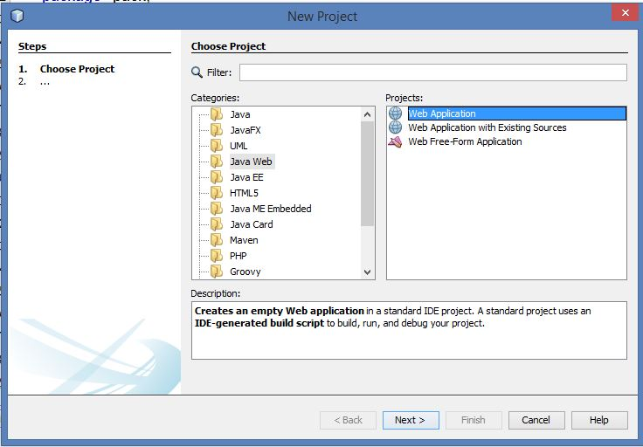
Steps to Web service Development
In Netbeans starts new web project, and select Java Web
Select Web Application in window as shown in fig. and click next

Slide 5
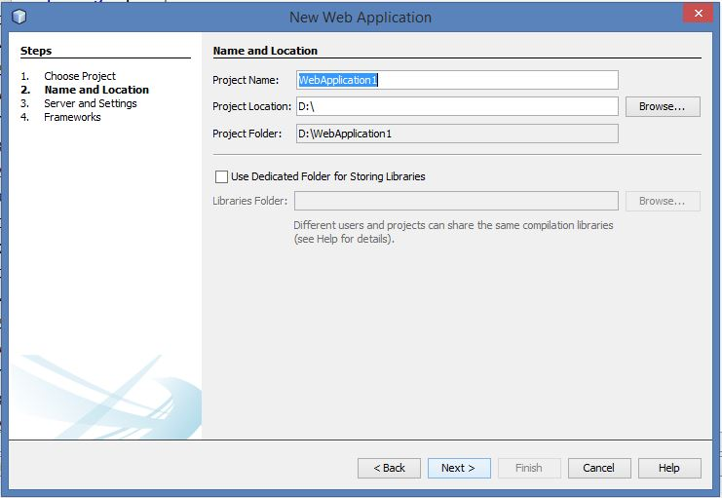
Contd…
Name your project and click next

Slide 6
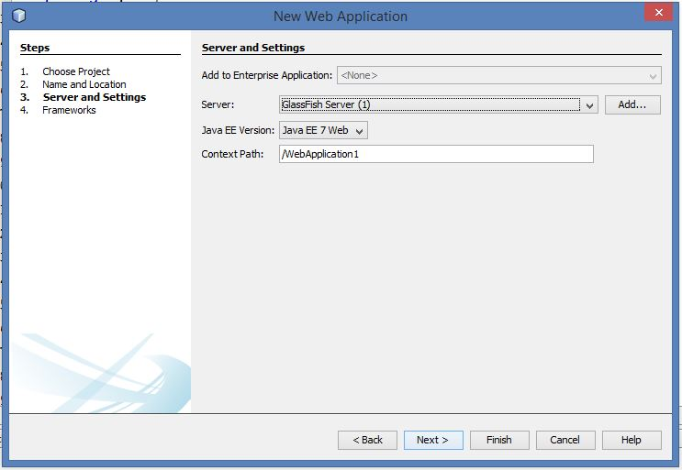
Contd…
Select the server from the drop-down list,
Glassfish is the default server of Netbeans, if you want to use any other web server then temporary select the Glassfish server and later we can deploy the application in another server.

Slide 7
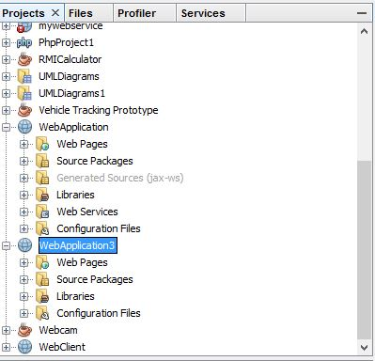
Contd…
After clicking on finish, a web application will be created in your Netbeans, can be seen in Project Explorer window.

Slide 8
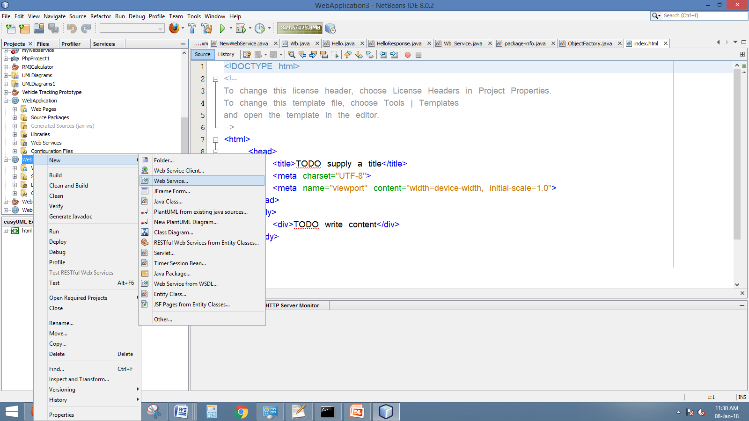
Contd…
Now Right Click on the your Web Service project and Select New->WebService option

Slide 9
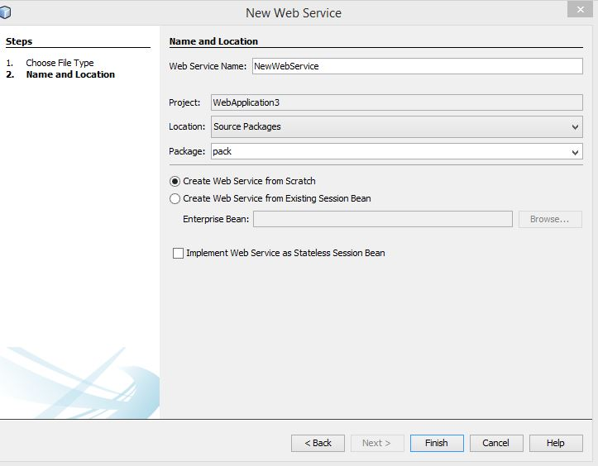
Contd…
Now give the name of the Web Service and package name.
Package name could be any of your choice.

Slide 10
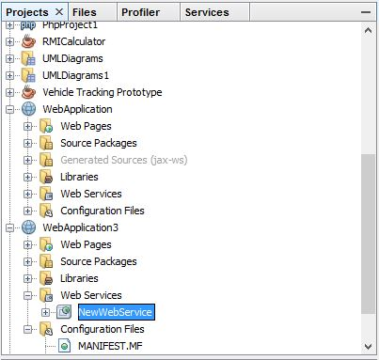
Contd…
A file will created in your project under the Web Services directory.

Slide 11
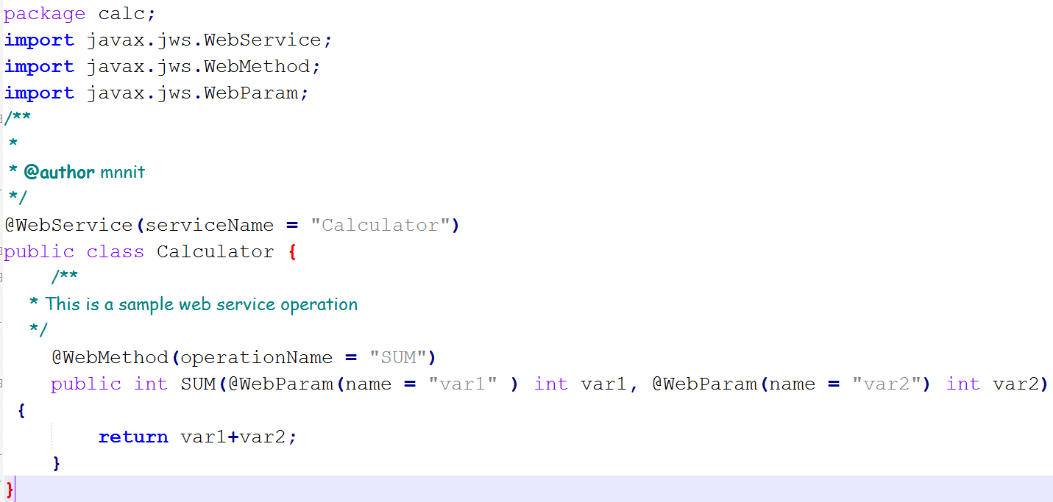
Contd…
After opening the file, a java code will open containing a default function.

Slide 12
In the previous fig,
Web service name is defined by line:
@WebService(serviceName = “Calculator")
Calculator is the class name and it must be public.
@WebMethod(operationName = “SUM") defines the operation name, it will be used by client to call this web service.
public int SUM(@WebParam(name = "var1" ) int var1, @WebParam(name = "var2") int var2) {
return var1+var2;
}

Slide 13
(@WebParam(name = "var1" ) int var1, @WebParam(name = "var2") int var2
Defines that service require two input arguments
The highlighted code is used to defined the function.
Here function will take two integer inputs and returns the Sum of these inputs.
After writing the code we have to compile the project.

Slide 14
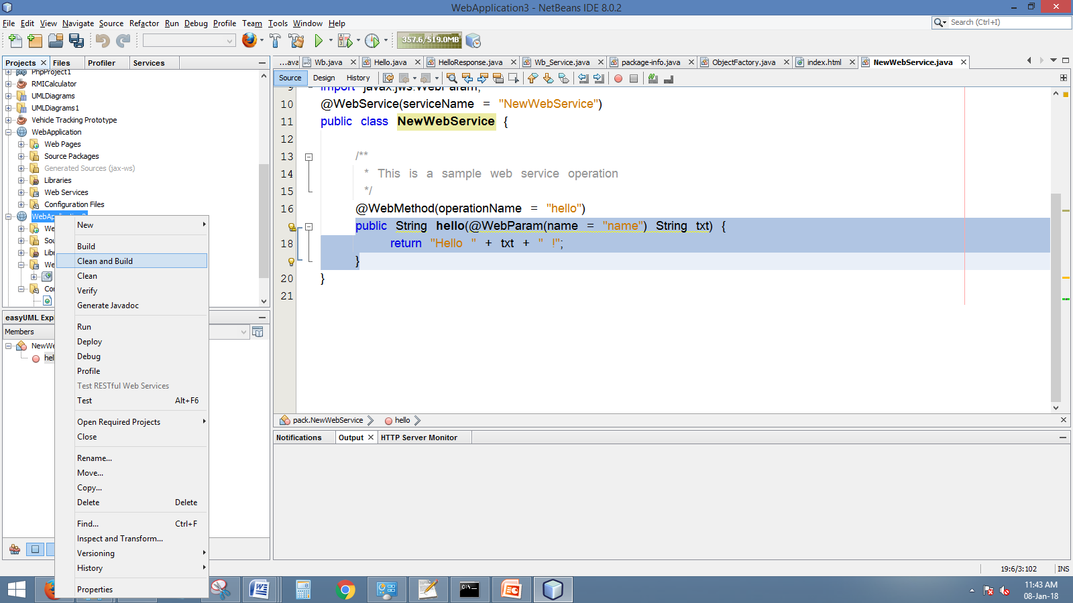
Contd…
To Compile the project:
Now Right Click on the project and select the
clean and build option.

Slide 15
Contd…
After the operation will compile the java program and will generate a web archive file for the project.
This web archive file has extension of “.war” i.e if your project name is “webapplication” then the file will be “webapplication.war”.
This file contains the webservice and can be deployed to any server that has Java run time such as Jboss, Weblogic, Glassfish etc.

Slide 16
Web Service Deployment
We use Oracle Weblogic server to deploy the web application.
Weblogic server is powerful server that provides interface for deploying various advanced projects such as ERP, Web Services, Web-applications etc.
We can download weblogic from Oracle website.
The downloded file will be jar file such ad “wls1036_generic.jar”
You must have (Java Development Kit) JDK version 6.0 above installed at your system.

Slide 17
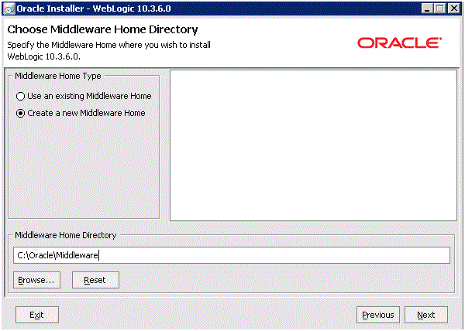
WebLogic Installation
Open a Command window with Run as Administrator option and run this command from the prompt:
>java -jar wls1036_generic.jar
On Welcome, click the Next button.

Slide 18
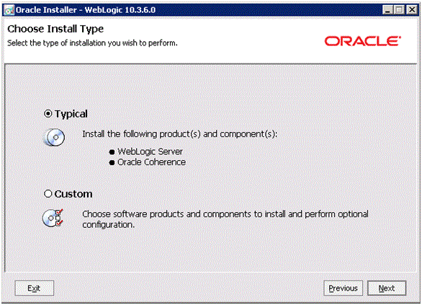
Contd…
Click the Next button.

Slide 19
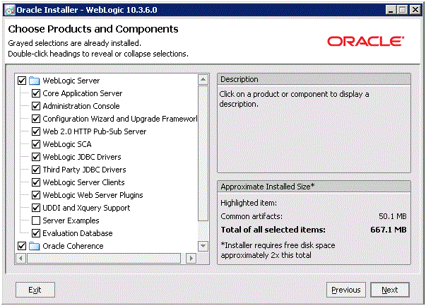
Contd…
On Choose Install Type, select the type of installation you wish to perform. it is assumed you select the Typical installation type.

Slide 20
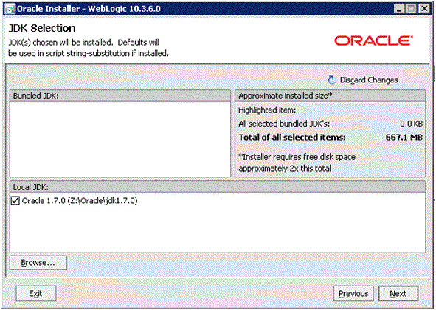
Contd…
Click the Next button and select jdk version.

Slide 21
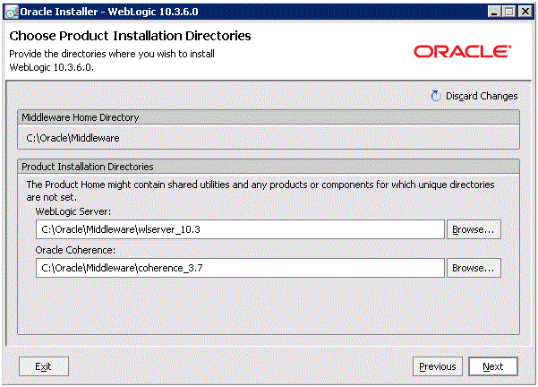
Contd…
Click Next

Slide 22
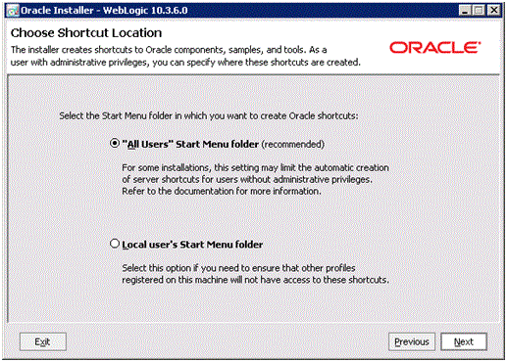
Click Next Button

Slide 23
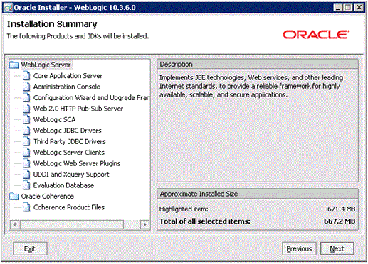
The window shows installation summary , now click next button

Slide 24
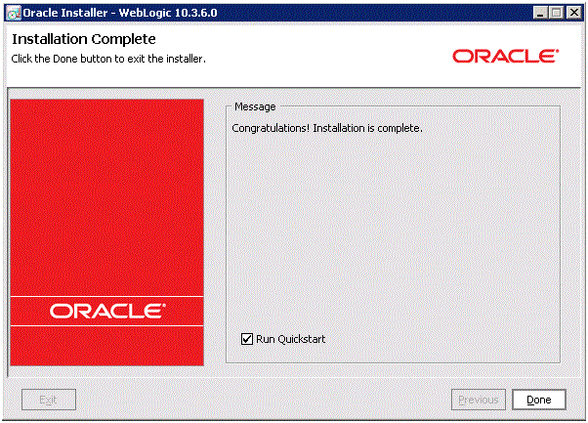
Contd…
Now installation is complete.

Slide 25
Configuration of WebLogic Server
After installation, configuration wizards is used to configure the server such as ip address, port number etc.
You can use QuickStart to create a starter domain using the Configuration Wizard.
To manually launch the QuickStart configuration wizard, run this executable:
<MY_HOME>\utils\quickstart\quickstart.cmd
MY_HOME is the directory where the server is installed.

Slide 26
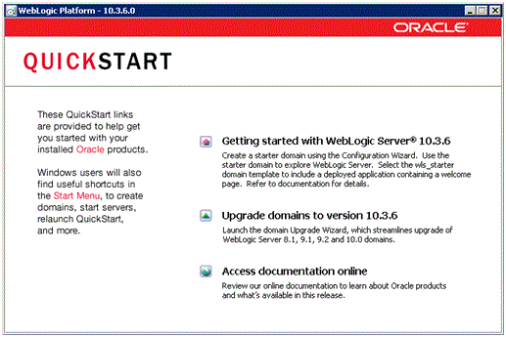
Contd…
On the QuickStart links panel, select this link: Getting started with WebLogic Server 10.3.6

Slide 27
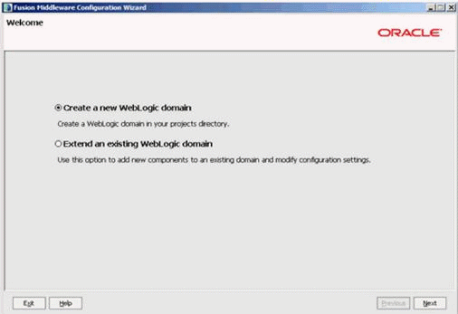
Contd…
On Welcome, click this radio button to create an Oracle WebLogic 10.3.6.0 domain in your projects directory.

Slide 28
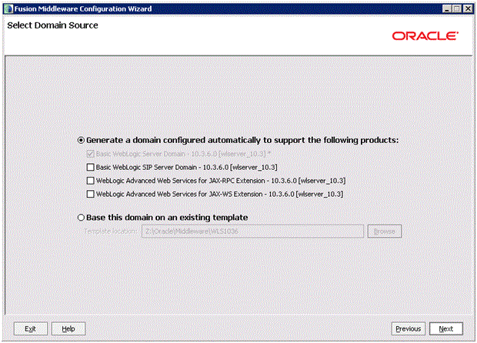
Create a new WebLogic domain
On Select Domain Source, click this radio button:
Generate a domain configured automatically to support the following products
In this section, ensure this default check box is also selected:
Basic WebLogic Server Domain - 10.3.6.0 [wlserver_10.3]*

Slide 29
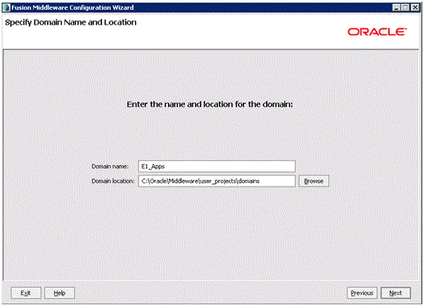
Contd…
Define domain name and click Next

Slide 30
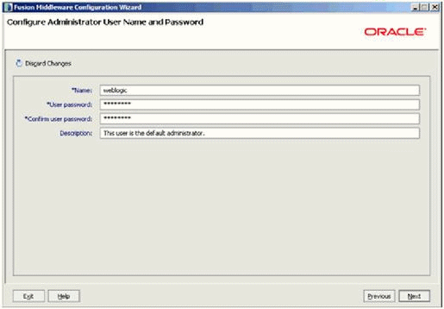
On Configure Administrator User Name and Password, complete the fields for user name and password for the default user that will start the domain.

Slide 31
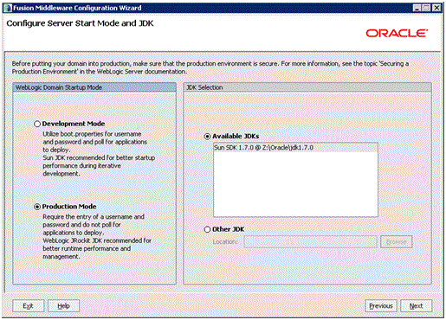
Contd…
Click on Next Button

Slide 32
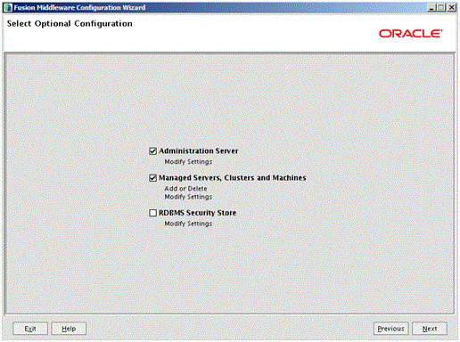
On Select Optional Configuration, select these check boxes to modify the server settings:
Administration Server
Managed Servers, Clusters and Machines

Slide 33
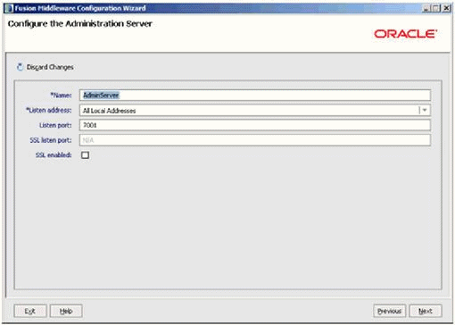
On Configure the Administration Server, complete these fields:
Name
Enter a name for the Administration Server. For example:
AdminServer
Listen address
Listen Port

Slide 34
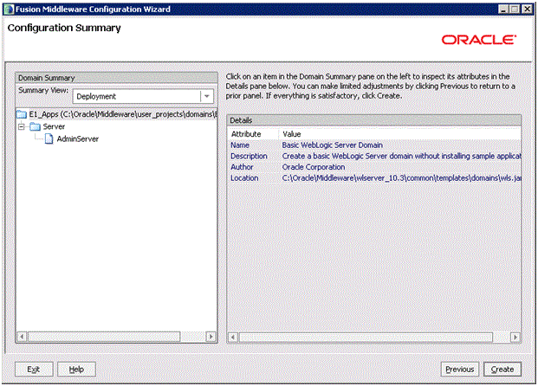
Click Next until following screen appears
Click on Create Button to create a server.

Slide 35
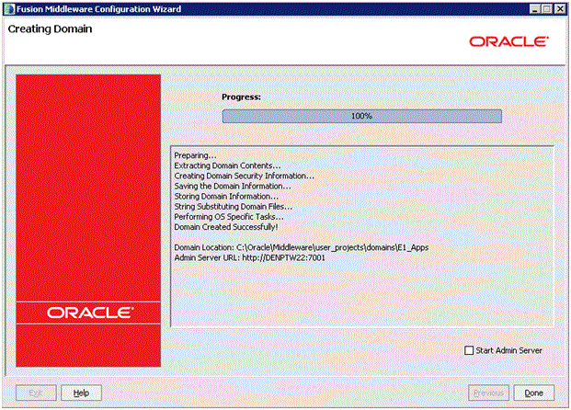
On Creating Domain, when the Progress bar indicates the process is 100% complete, click the Done button to exit the wizard.

Slide 36
Contd…
To run the weblogic server, open the browser and go to following URL:
http://ip:port/console
For example your local ip is 172.31.134.3 and port number you configured in previous step is 7001 then the admin page address will be:
http://172.31.134.3:7001/console.

Slide 37
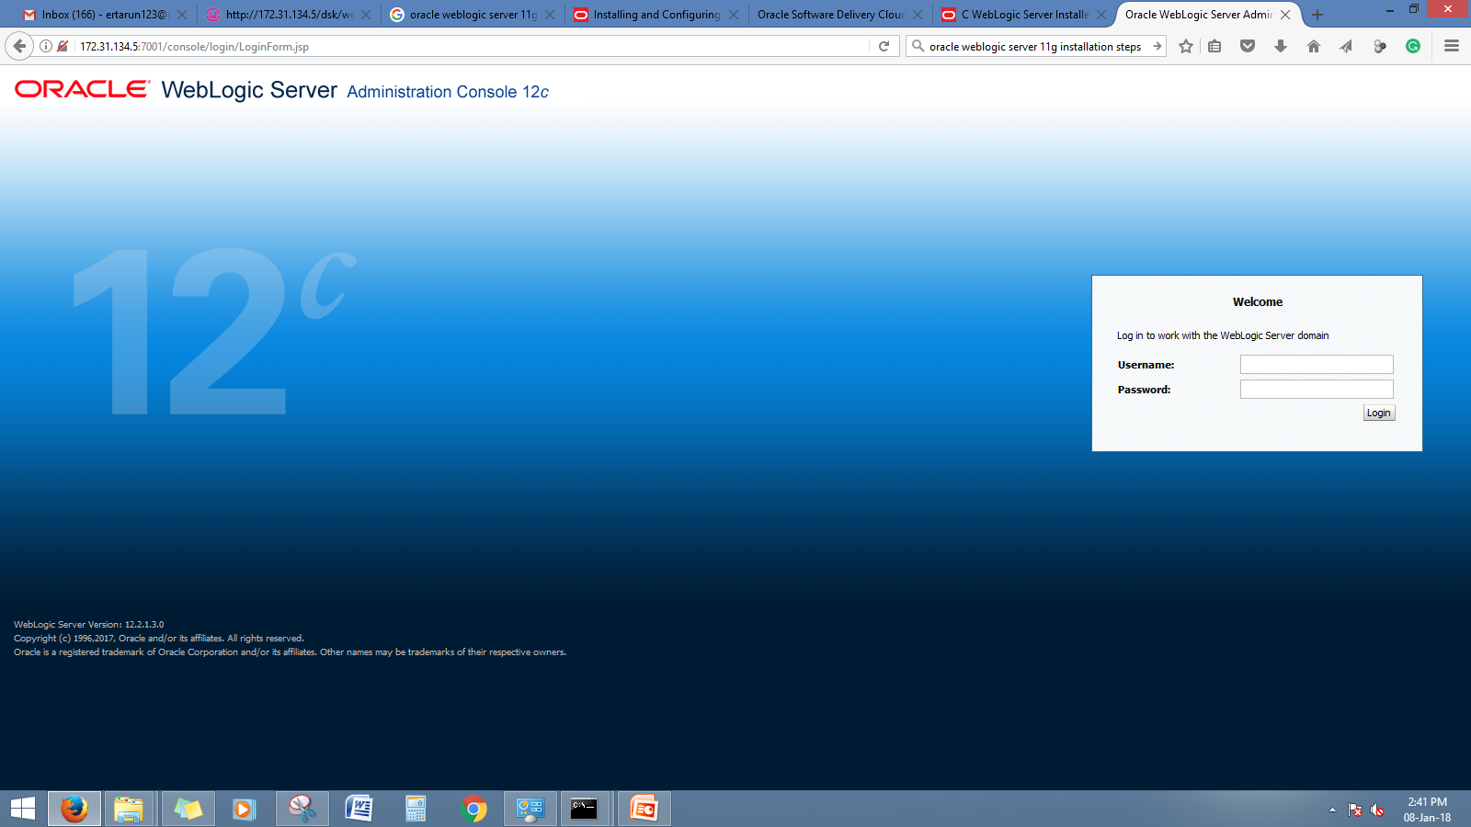
Deployment of Web service in WebLogic
Open the admin page of the server by opening the following link:
http://172.31.134.3:7001/console
Fill the username and password details in the form

Slide 38
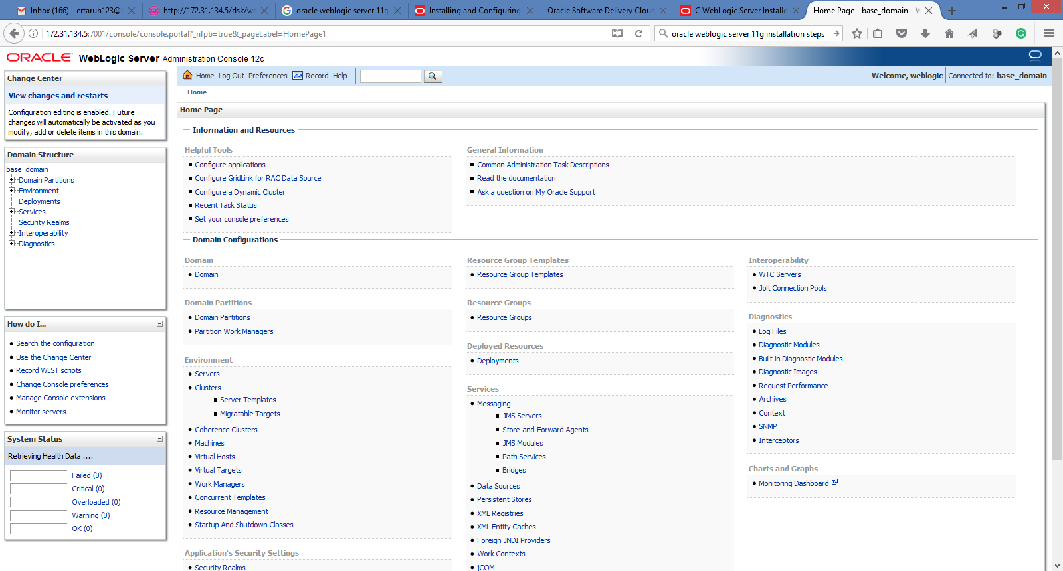

Slide 39
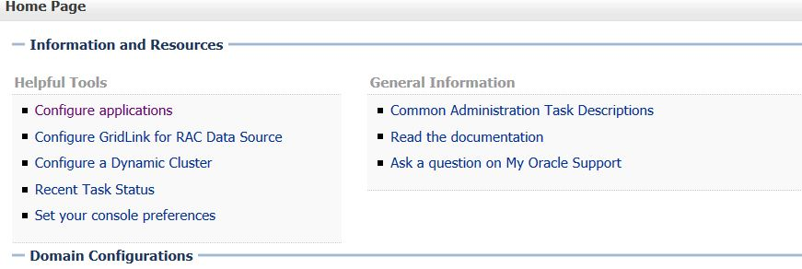
Contd…
Click on Configure application link in home page

Slide 40
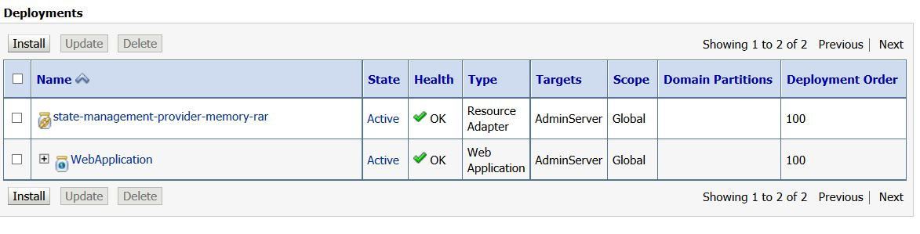
Contd…
Click on Install button to deploy a web application

Slide 41
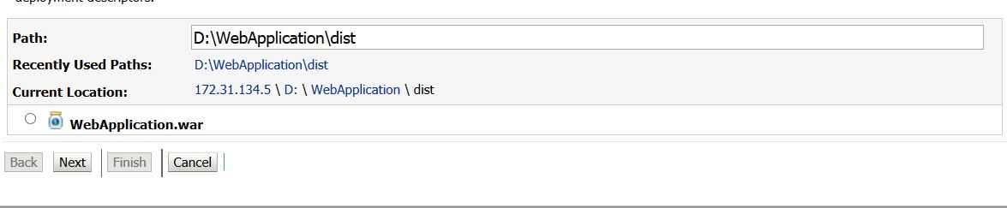
Contd…
Select the path of the webservice, where the “webapplication.war” is stored.
And select the application and click Next

Slide 42
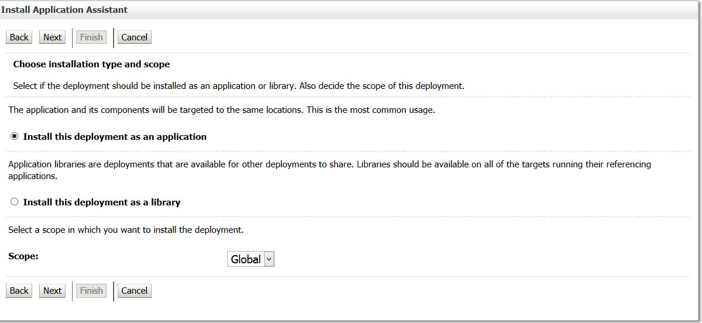
Contd…
Now click Next, until the process is not finish.

Slide 43
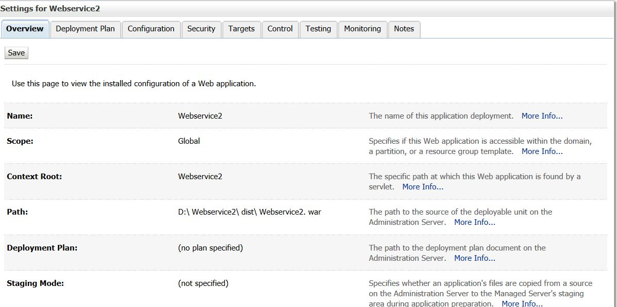
Following screen shows, your application deployed successfully.
Now you can test your web service by clicking on Testing Tab.

Slide 44
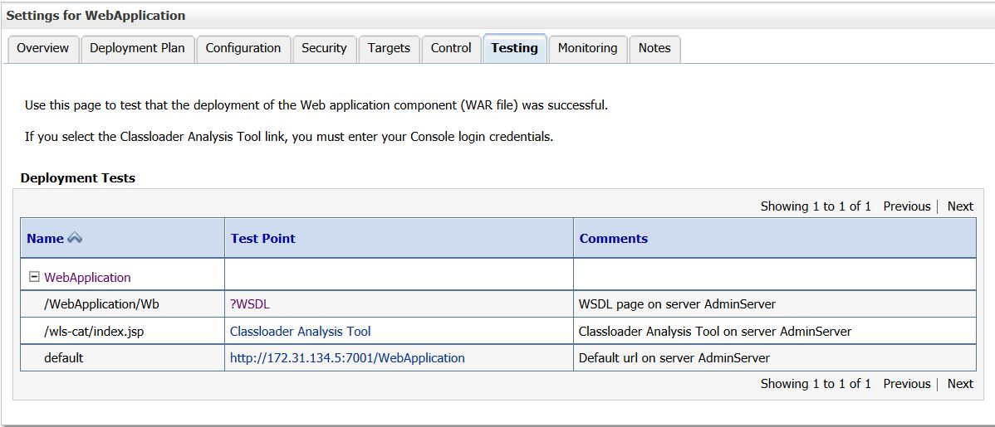
Contd…
To Test the web service click on ?wsdl link on following screen

Slide 45
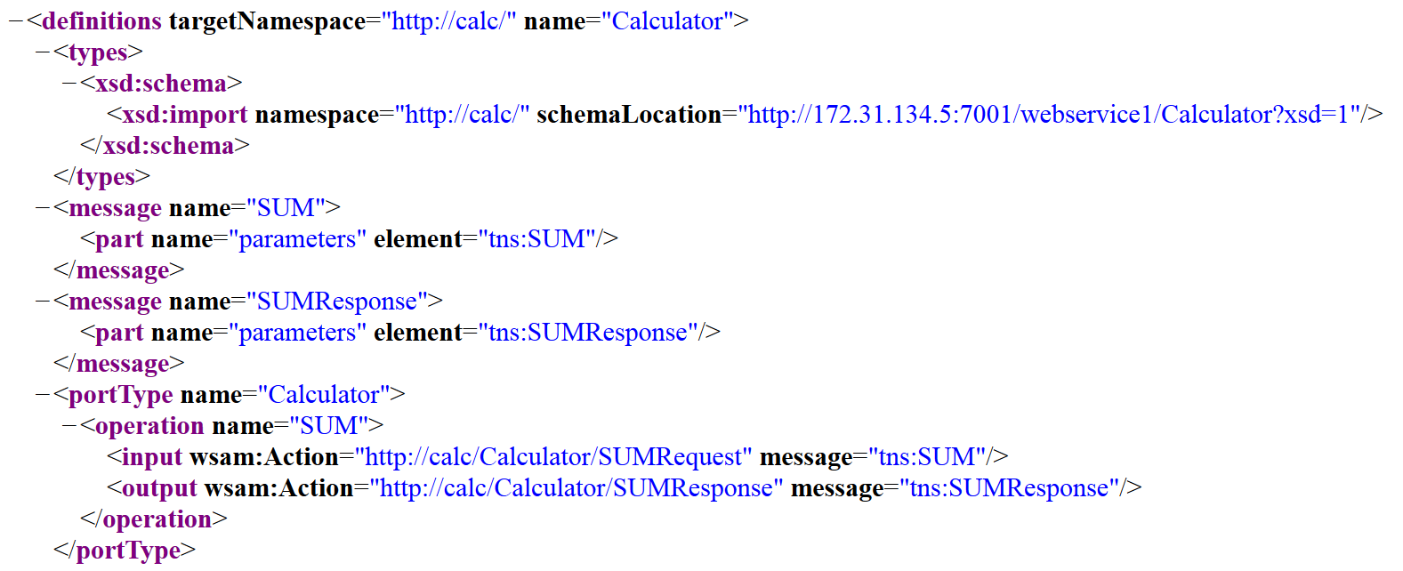
After Clicking on ?wsdl link you will get WSDL file of your web service.

Slide 46
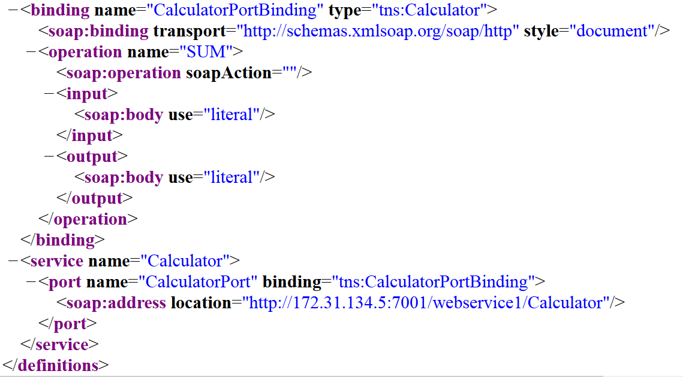
WSDL Contd’

Slide 47
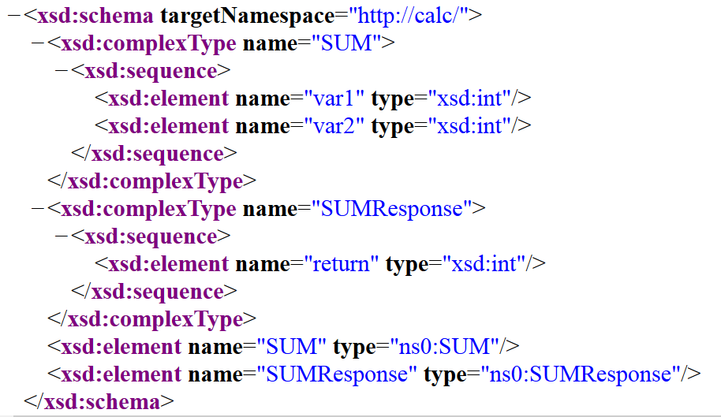
Namespace

Slide 48
Developing Web Service Client application
The webservice is now ready and deployed in weblogic server.
The web service can be used by any client by exchanging the SOAP massage.
To test the developed webservice, we will create client in PHP.

Slide 49
PHP SOAP Client
To develop any application
Perquisite knowledge of WAMP or LAMP
Basic PHP
Assuming your using WAMP,
First create directory in under the “www” directory in WAMP location.
Let the directory name is “client”
Create a php file named as “webclient.php” in this directory.

Slide 50
Configuration for SOAP Client in PHP
To execute the SOAP client in PHP, we have to enable soap extension package in “php.ini” file.
To do so, locate this file in (only for wamp server) “C:\wamp\bin\php\php5.3.0” and open “php.ini” file in notepad or any editor.
Now search for the following line in the file
;extension=php_soap.dll
And remove the semicolon to enable the soap.
Now save the file and restart the wamp server.

Slide 51
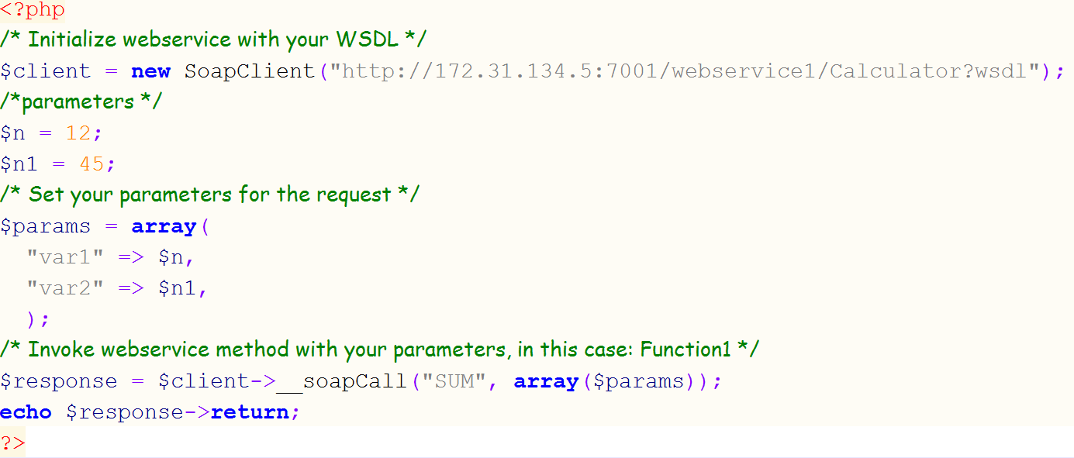
PHP webclient.php

Slide 52
In the previous program:
“var1” and “var2” are the input argument that are defined in WSDL document.
“SUM” is the name of the function defined in web service.
Above program will call the function “SUM” in “Calculator” webservice.
The SOAP call will return the SUM of two input arguments.

Slide 53
Contd…
Let wamp server is running on IP 172.31.34.6 then
To run the webclient open browser and go to following URL
http://172.31.34.6/client/webclient.php

